Slide 1
The breaking point?
Kevin Johnson
October 20th, 2009

Slide 2

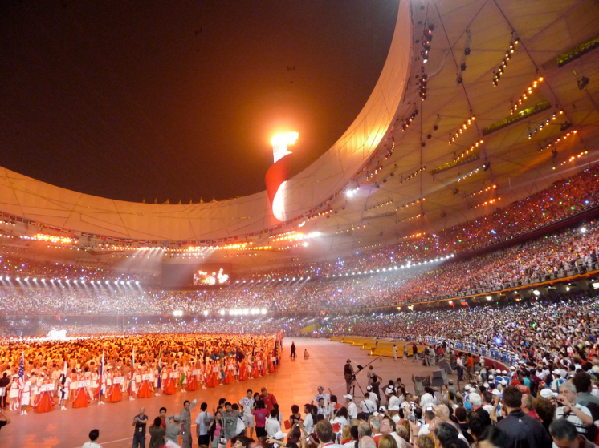
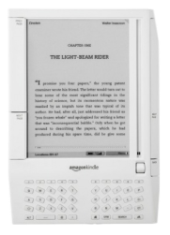
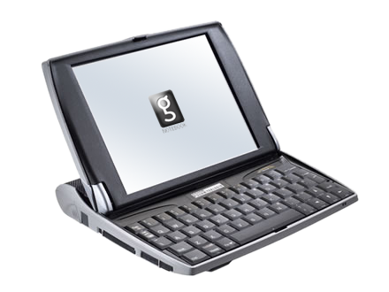
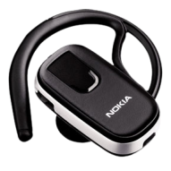
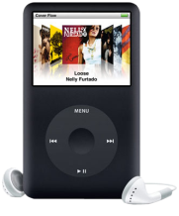
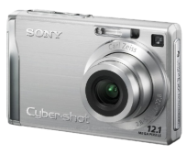


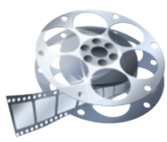
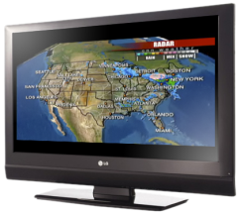

A Decade Of Change
1999–2009
Human Genome Project Successfully Maps Complete Human DNA
Human Genome Project Successfully Maps Complete Human DNA
Beijing Olympics Symbolizes the Emergence and Growth of New Economies Worldwide
Beijing Olympics Symbolizes the Emergence and Growth of New Economies Worldwide
The Digital
Decade
Arrives

Slide 3




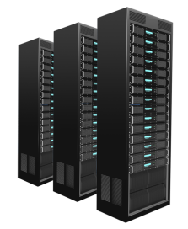




The connected culture
2010–2020
Proliferation of Devices
Content Consumption
Connected Socialization
Machine to Machine

Slide 4





internet traffic is growing
5
Worldwide internet traffic, 1990-2008 PB/month
Worldwide internet traffic, 1990-2020 PB/month
240,000
212,000
185,500
159,000
132,500
106,000
79,500
53,000
26,500
# of Connections
Plus Machine to Machine?
9,000
8,000
7,000
6,000
5,000
4,000
3,000
2,000
1,000
Forecast Model
+32%
2008-2020
CAGR
27x Growth
2008-2020
WWW is born
+36%
Video
Digital decade
+24%
Non-
video
1990
1990
1992
1993
1994
1996
1996
1999
2002
1998
2005
2000
2008
2002
2011
2004
2014
2006
2017
2008
Source: Juniper, Cisco, MINTS
2020
Notes:
4

Slide 5
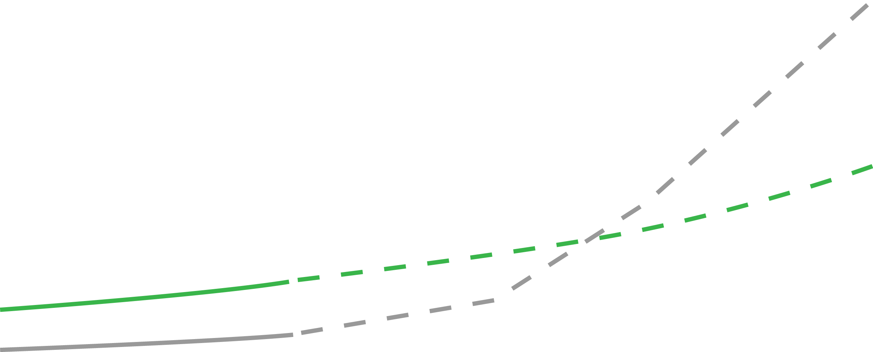

At Current Pace Of Innovation network investment Outpaces Revenue
Worldwide service provider revenue vs. investments with innovation, 2003-2009 $ in USD Billion
Worldwide service provider revenue vs. investments with innovation, 2003-2020 $ in USD Billion
$500
Forecast Model
$1,500
$1,250
Are consumers prepared to pay $385 for broadband connectivity?
$400
$1,000
$300
Revenue
$750
Continued improvements driving down capex and opex at the historical rate only delay the inevitable breaking point
$500
$200
$250
Investment
$100
2003
2003
2005
2004
2007
2005
2009
2011
2006
2013
2007
2015
2008
2017
2009
2019
Note: Investments include both annual capex and opex forecasts for IP; revenue based on linear regression with R²=0.98836 plus incremental revenue from scaling existing video delivery; capex adjusted for annual improvements of 31.38% reflecting combined historical capacity improvements and price reductions; opex adjusted for annual improvements of 29.49% reflecting historical opex improvements
Historical Revenue from IP
Historical Investment from IP
Forecasted Revenue from IP
Forecasted Investment from IP
Source: Juniper, Cisco, MINTS, Infonetics

Slide 6

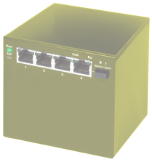
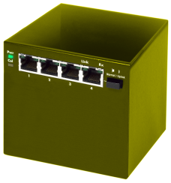
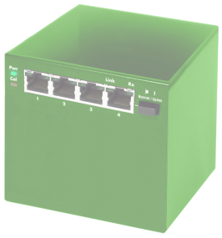

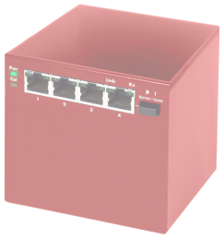
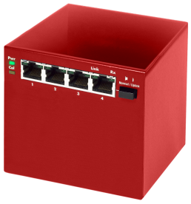
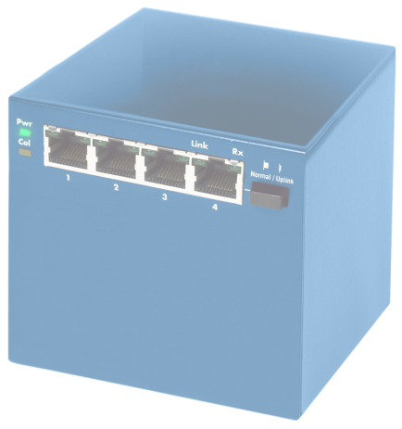

Driving To A Platform view
What we need to get past
What we need to get past
One example…
    Thinking it’s about the box
    Thinking it’s about the box
    Established to solve the new media problem
    Needed an open platform on which to scale
    Needed to drive more value into the network equation
    Partnering with Juniper to deliver new solutions

Slide 7

Scale Or Fail
Together we need to innovate…
    With simplified infrastructures that increase flexibility and improve ROI
    With automation that reduces operational costs
    With business models that enable new revenue sources
    With environment efficiencies that save energy and costs

